Slide 1
Utility

Slide 2
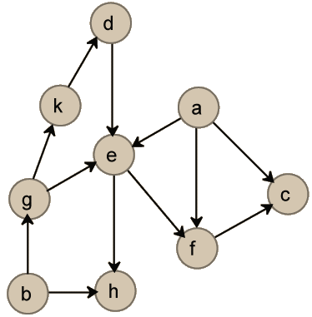
Reminder: preferences
DAG (Directed Acyclic Graph)
There is a direct edge from i to j if j ≻ i

Slide 3
Reminder: preferences
There is a direct edge from i to j if j ≻ i
Q: which are the most preferred nodes?

Slide 4
Reminder: preferences
There is a direct edge from i to j if j ≻ i
Q: which are the least preferred nodes?

Slide 5
Reminder: preferences
There is a direct edge from i to j if j ≻ i
Q: is k preferred to f?

Slide 6
Reminder: preferences
There is a direct edge from i to j if j ≻ i
Q: is h preferred to f?

Slide 7
Reminder: preferences
There is a direct edge from i to j if j ≻ i
Q: how can I identify two indifferent nodes?

Slide 8
Reminder: preferences
There is a direct edge from i to j if j ≻ i
Q: Is this preference relation transitive?

Slide 9

The Concept of Utility Representation
If the number of alternatives is small
preference relation can be an ordered list from best to worst

Slide 10
The Concept of Utility Representation
In some cases, the alternatives are grouped into a small number of categories
we describe the preferences on X by specifying the preferences on the set of categories

Slide 11
The Concept of Utility Representation
“I prefer the fastest car”
“I prefer the taller basketball player”
“I prefer the more expensive present”
“I prefer a teacher who gives higher grades”

Slide 12
The Concept of Utility Representation
They can naturally be specified by
x ≿ y if V(x) ≥ V(y) (or V(x) ≤ V(y)), where V : X → ℝ
For example, the preferences stated by “I prefer the taller basketball player” can be expressed formally by
X is the set of all conceivable basketball players, and V(x) is the height of player x

Slide 13
The Concept of Utility Representation
Note that the statement x ≿ y if V(x) ≥ V(y) always defines a preference relation because…
… the relation ≥ on ℝ satisfies completeness and transitivity

Slide 14
The Concept of Utility Representation
We say that the function U : X → ℝ represents the preference ≿ if for all x and y ∈ X, x ≿ y iff U(x) ≥ U(y)
If the function U represents the preference relation ≿ , we refer to it as a utility function, and we say that ≿ has a utility representation

Slide 15
The Concept of Utility Representation
Claim:
If U represents ≿, then for any strictly increasing function f : ℝ → ℝ , the function V(x) = f(U(x)) …
… represents ≿ as well
Proof:
a ≿ b
iff U(a) ≥ U(b) (since U represents ≿ )
iff f(U(a)) ≥ f(U(b)) (since f is strictly increasing)
iff V(a) ≥ V(b)

Slide 16
The Concept of Utility Representation
Claim:
If U represents ≿, then for any strictly increasing function f : ℝ → ℝ, the function V(x) = f(U(x)) represents ≿ as well
What does this mean?
Various forms of utility functions may exist to represent a preference relation

Slide 17

Existence of a Utility Representation
If any preference relation could be represented by a utility function, then…

Slide 18
Existence of a Utility Representation
If any preference relation could be represented by a utility function, then it would “grant a license” to use utility functions rather than preference relations with no loss of generality
Why is this important?

Slide 19
Reminder: preferences
Easier to compare two items
Q: is k preferred to f?

Slide 20
Existence of a Utility Representation
Possibility of numerical representations carrying additional meanings
Ex:
a is preferred to b more than c is preferred to d

Slide 21
Existence of a Utility Representation
Under what assumptions do utility representations exist?

Slide 22
Existence of a Utility Representation
Lemma:
In any finite set A ⊆ X, there is a minimal element (similarly, there is also a maximal element)
That is, there is an element that is less preferred to any other element
Which property guarantees that?

Slide 23
Existence of a Utility Representation
Lemma:
In any finite set A ⊆ X, there is a minimal element (similarly, there is also a maximal element)
Proof:
By induction on the size of A
If A is a singleton, then by completeness its only element is minimal
For the inductive step, let A be of cardinality n+1 and let x∈ A. The set A − {x} is of cardinality n and by the inductive assumption has a minimal element denoted by y
If x ≿ y, then y is minimal in A
If y ≿ x, then by transitivity z ≿ x for all z ∈ A−{x}, and thus x is minimal

Slide 24
Reminder
Recall that X is countable and infinite if there is a one-to-one function from X onto the natural numbers
It is possible to specify an enumeration of all its members
{x_{n}}_{n=1,2,...}

Slide 25
Existence of a Utility Representation
Claim:
If X is countable, then any preference relation on X has a utility representation with a range (−1, 1)

Slide 26
Existence of a Utility Representation
Proof:
Let {x_{n}} be an enumeration of all elements in X
Set U(x₁) = 0
Assume that you have completed the definition of the values U(x₁), . . . ,U(x_{n−1}) so that x_{k} ≿ x_{l} iff U(x_{k}) ≥ U(x_{l})
If x_{n} is indifferent to x_{k} for some k < n, then assign U(x_{n}) = U(x_{k})
If not, by transitivity, all numbers in the nonempty set {U(x_{k})| x_{k}≺ x_{n}} ∪ {−1} are below all numbers in the nonempty set {U(x_{k})| x_{k} ≻ x_{n} } ∪ {1}
Choose U(x_{n}) to be between the two sets
This guarantees that for any k < n we have x_{n} ≿ x_{k} iff U(x_{n}) ≥ U(x_{k})
Thus, the function defined on {x₁, . . . , x_{n}} represents the preferences on those elements
To complete the proof that U represents ≿, take any two elements, x and y ∈ X. For some k and l we have x = x_{k} and y = x_{l}. The above applied to n = max{k, l} yields x_{k} ≿ x_{l} iff U(x_{k}) ≥ U(x_{l})

Slide 27

Existence of a Utility Representation
Let’s put that in practice…

Slide 28
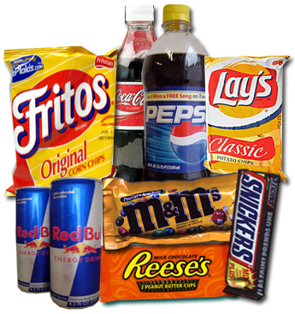
Which bundle do you prefer?
Bundle #1
3 chocolates
6 snacks
4 sodas
Bundle #2
2 chocolates
2 snacks
10 sodas
Bundle #3
1 beer
1 snack
1 chocolate

Slide 29
Lexicographic Preferences
Bundle #1
3 chocolates
6 snacks
4 sodas
Bundle #2
2 chocolates
2 snacks
10 sodas
Bundle #3
1 beer
1 snack
1 chocolate

Slide 30
Lexicographic Preferences
Let (≿ _{k})_{k=1,...,K} be a K-tuple of preferences over the set X
The lexicographic preferences induced by those preferences are defined by x ≿ _{L} y if
(1) there is k∗ such that for all k < k∗ we have x ∼_{k} y and x ≻_{k∗} y or
(2) x ∼_{k} y for all k
The lower the k, the more relevant it is

Slide 31
Lexicographic Preferences
Example:
Let X be the unit square, that is, X = [0, 1] × [0, 1]
Let x ≿_{k} y if x_{k} ≥ y_{k}
The lexicographic preferences ≿_{L} induced from ≿ ₁ and ≿ ₂ are:
(a₁, a₂) ≿_{L} (b₁, b₂) if a₁ > b₁ or both a₁ = b₁ and a₂ ≥ b₂

Slide 32
Lexicographic Preferences
Claim:
The lexicographic preference relation ≿_{L} on [0, 1] × [0, 1], induced from the relations x ≿_{k} y if x_{k} ≥ y_{k} (k = 1, 2), does not have a utility representation

Slide 33
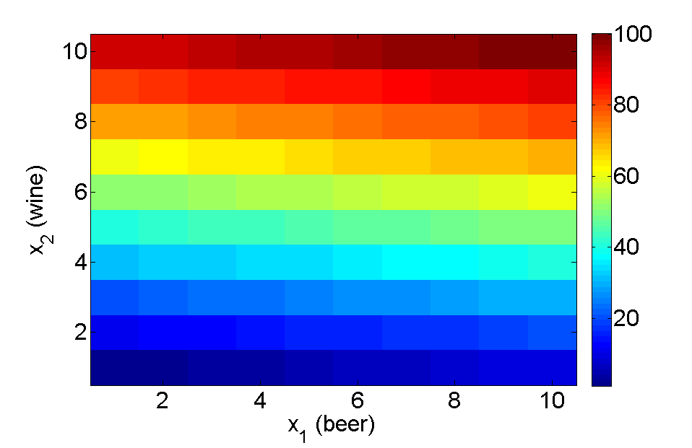
Lexicographic Preferences
Why it cannot be represented by a utility function?
(x₁,x₂) ≿ (y₁,y₂) if
(x₂ > y₂) or
(x₂ = y₂ and x₁ > y₁)

Slide 34
Lexicographic Preferences
Proof:
Theorem: ℝ is uncountable
Theorem: every subset of ℚ is countable
Corollary: there is no one-to-one function f : ℝ → ℚ
Theorem: ℚ is dense in ℝ
Notes:
(7) Lecture 45(B): Lexicographic Preference - YouTube

Slide 35
Lexicographic Preferences
Proof:
Assume by contradiction that the function u : X → ℝ represents ≿_{L}
For any a ∈ [0, 1], (a, 1) ≻_{L} (a, 0) and, therefore, u(a, 1) > u(a, 0)
Let q(a) be a rational number in the nonempty interval I_{a} = (u(a, 0), u(a, 1))
The function q is a function from [0, 1] into the set of rational numbers ℚ
It is a one-to-one function since if b > a, then (b, 0) ≻_{L} (a, 1), u(b, 0) > u(a, 1), and, therefore, the intervals I_{a} and I_{b} are disjoint
For all b, there is a rational q(b) number
Thus, q(a) ≠ q(b)
But the cardinality of the rational numbers is lower than that of the continuum, a contradiction
Notes:
(7) Lecture 45(B): Lexicographic Preference - YouTube

Slide 36
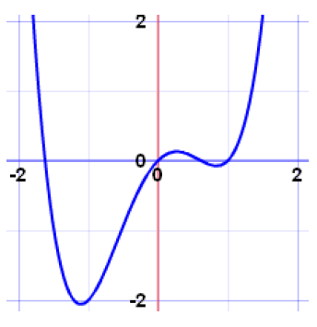
Reminder: continuous functions
Is this function continuous?

Slide 37

Reminder: continuous functions
A function is continuous when its graph is a single unbroken curve…
… that you could draw without lifting your pen from the paper

Slide 38
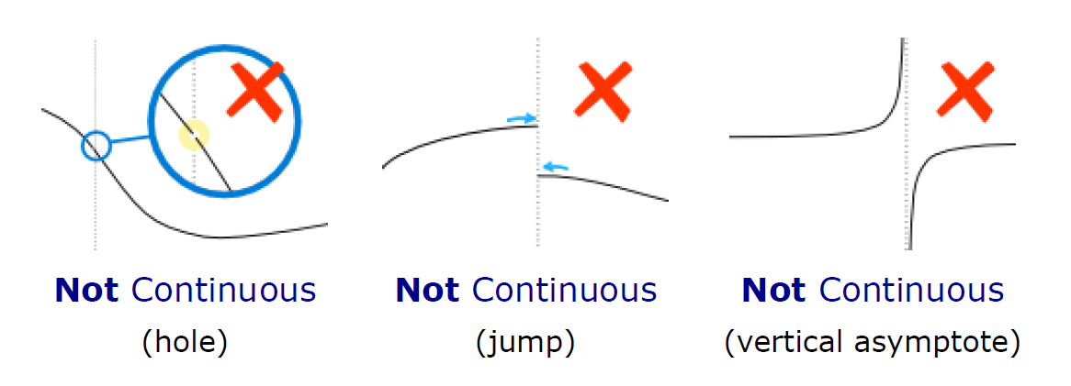
Reminder: continuous functions
Examples:

Slide 39
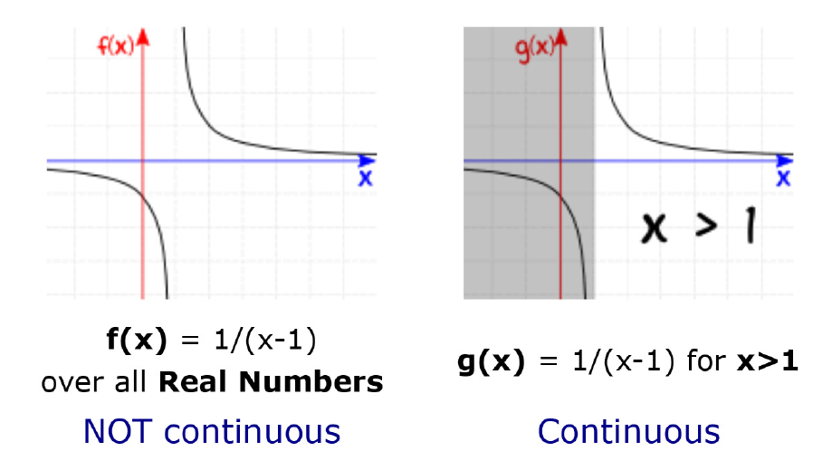
Reminder: continuous functions
Examples:

Slide 40
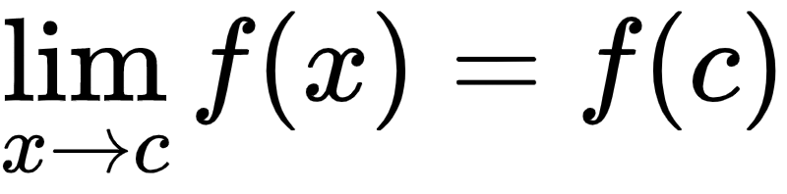
Reminder: continuous functions
Formal definition:
A function f is continuous when, for every value c in its Domain:
f(c) is defined, and
the limit of f(x) as x approaches c equals f(c)
“as x gets closer and closer to c, f(x) gets closer and closer to f(c)”

Slide 41
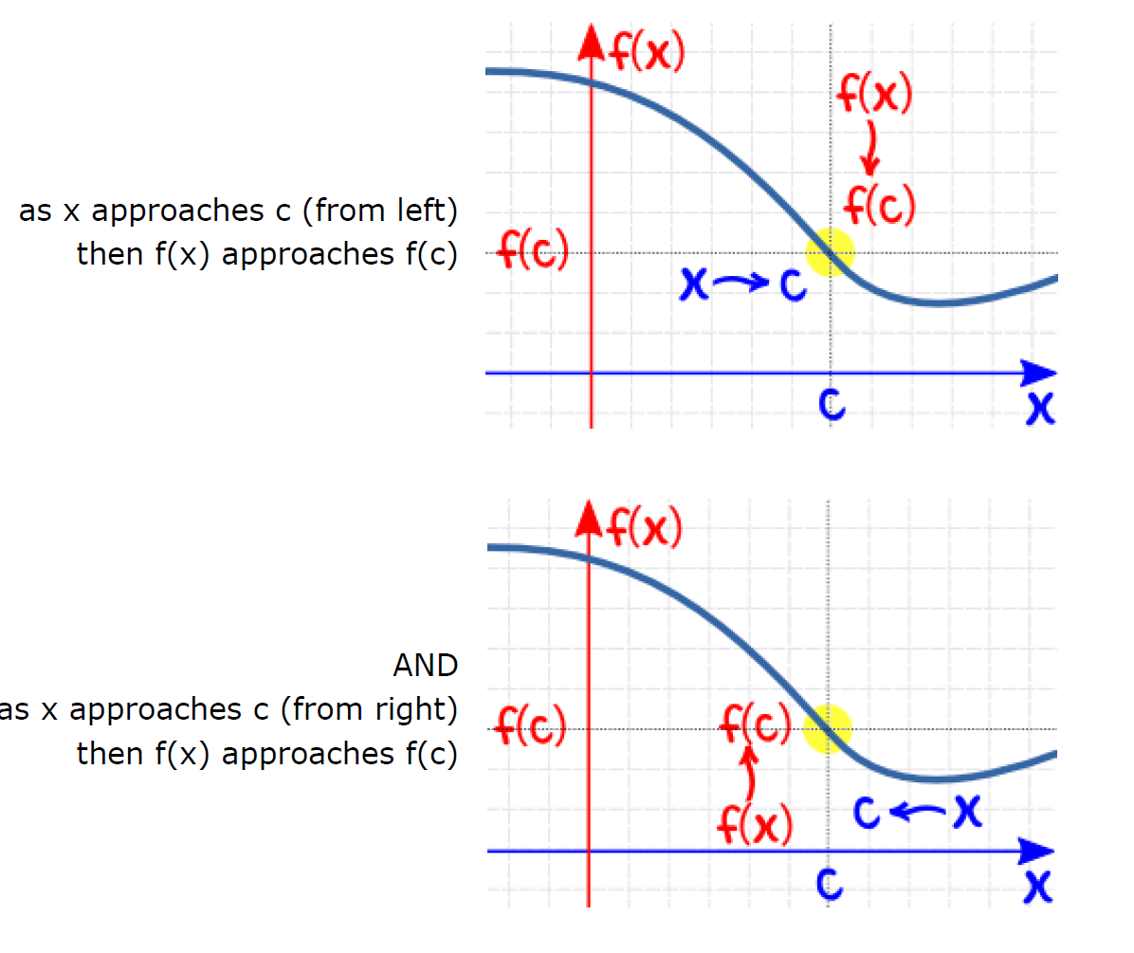
Reminder: continuous functions

Slide 42
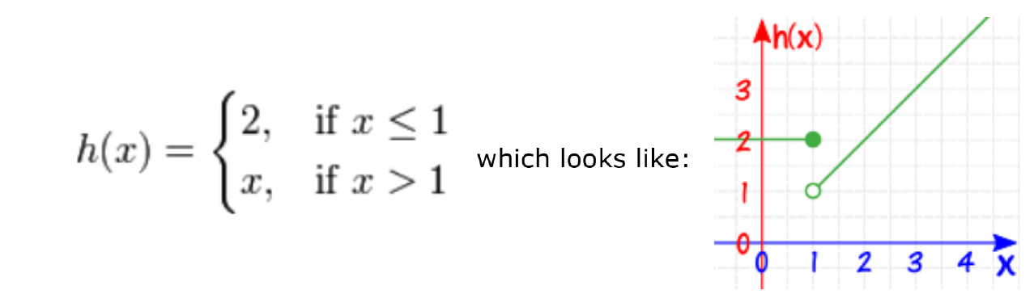
Reminder: continuous functions
It is defined at x=1, since h(1) = 2
But you cannot say what the limit is at x=1
from the left: 2
from the right: 1
Notes:
\begin{equation}
h(x)=
\begin{cases}
2, & \text{if}\ x \leq 1 \\
x, & \text{if}\ x > 1
\end{cases}
\end{equation}

Slide 43
Continuity of Preferences
Why is it important to talk about this?

Slide 44
Continuity of Preferences
In economics, the set X is often an infinite subset of a Euclidean space
In ℝ¹
Ex: gold
In ℝ²
Ex: (salary, vacation time per year)
In ℝ³
Ex: (coffee, bread, milk)

Slide 45
Continuity of Preferences
In economics, the set X is often an infinite subset of a Euclidean space
Is there a utility representation in such a case?

Slide 46




Continuity of Preferences
Which one do you prefer?
12 free months
100k miles
OR
20 boosters
120

Slide 47
Continuity of Preferences
Which one do you prefer?
12 free months
99.8k miles
OR
19 boosters
120

Slide 48
Continuity of Preferences
Which one do you prefer?
12 free months
100k miles
OR
20 boosters
119

Slide 49
Continuity of Preferences
The basic intuition, captured by the notion of a continuous preference relation, is that if a is preferred to b, then “small” deviations from a or from b will not reverse the ordering

Slide 50
Continuity of Preferences
Definition C1
A preference relation ≿ on X is continuous if whenever a ≻ b there are balls (neighborhoods in the relevant topology) B_{a} and B_{b} around a and b, respectively, such that for all x ∈ B_{a} and y ∈ B_{b}, x ≻ y

Slide 51
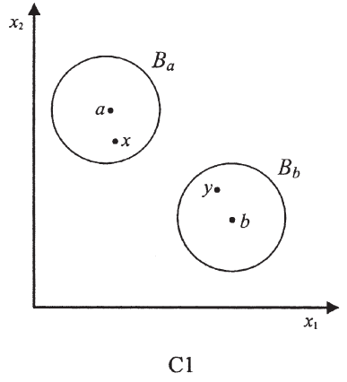
Continuity of Preferences
Definition C1
bread
milk

Slide 52
Continuity of Preferences
Definition C2
A preference relation ≿ on X is continuous if the graph of ≿ (i.e., the set {(x, y)|x ≿ y} ⊆ X × X) is a closed set (with the product topology)
That is, if {(a_{n}, b_{n})} is a sequence of pairs of elements in X satisfying a_{n} ≿ b_{n} for all n and a_{n} → a and b_{n} → b, then a ≿ b

Slide 53
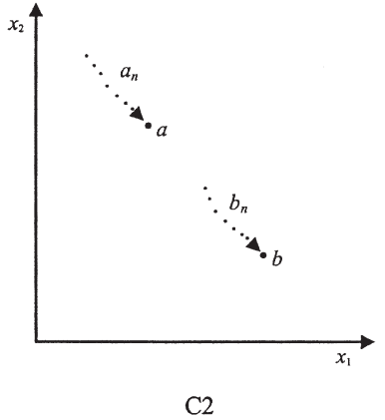
Continuity of Preferences
Definition C2
bread
milk

Slide 54
Continuity of Preferences
Claim:
The preference relation ≿ on X satisfies C1 if and only if it satisfies C2

Slide 55
Continuity of Preferences
Proof: (if)
Assume that ≿ on X is continuous according to C1. Let {(a_{n}, b_{n})} be a sequence of pairs satisfying a_{n} ≿ b_{n} for all n and a_{n} → a and b_{n} → b
If it is not true that a ≿ b (i.e., b ≻ a), then there exist two balls B_{a} and B_{b} around a and b, respectively, such that for all y ∈ B_{b} and x ∈ B_{a}, y ≻ x
There is an N large enough such that for all n > N, both b_{n} ∈ B_{b} and a_{n} ∈ B_{a}
Therefore, for all n > N, we have b_{n} ≻ a_{n}, which is a contradiction

Slide 56
Continuity of Preferences
Proof: (only if)
Assume that ≿ is continuous according to C2
Let a ≻ b
Assume by contradiction that for all n there exist a_{n}∈ Ball(a, 1/n) and b_{n}∈ Ball(b, 1/n) such that b_{n} ≿ a_{n}
The sequence (b_{n}, a_{n}) converges to (b, a)
By the second definition, (b, a) is within the graph of ≿, that is, b ≿ a, which is a contradiction

Slide 57
Continuity of Preferences
Remark #1
≿ on X is represented by a continuous function U, then ≿ is continuous
To see this, note that if a ≻ b, then U(a) > U(b)
Let ε = (U(a) − U(b))/2
By the continuity of U, there is a δ > 0 such that for all x distanced less than δ from a, U(x) > U(a) − ε, and for all y distanced less than δ from b, U(y) < U(b) + ε
Thus, for x and y within the balls of radius δ around a and b, respectively, x ≻ y

Slide 58
Continuity of Preferences
Remark #2
The lexicographic preferences that were used in the counterexample to the existence of a utility representation are not continuous
Why?
This is because (1, 1) ≻ (1, 0), but in any ball around (1, 1) there are points inferior to (1, 0)

Slide 59
Continuity of Preferences
Remark #2
The lexicographic preferences that were used in the counterexample to the existence of a utility representation are not continuous

Slide 60
Continuity of Preferences
Remark #3
Note that the second definition of continuity can be applied to any binary relation over a topological space, not just to a preference relation
For example, the relation = on the real numbers (ℝ) is continuous, whereas the relation ≠ is not
Why?

Slide 61
Debreu's theorem
Continuous preferences have a continuous utility representation
Proof in the book

Slide 62
Reminder
Claim:
If U represents ≿ , then for any strictly increasing function f : ℝ → ℝ , the function V(x) = f(U(x)) represents ≿ as well
Proof:
a ≿ b
iff U(a) ≥ U(b) (since U represents ≿ )
iff f(U(a)) ≥ f(U(b)) (since f is strictly increasing)
iff V(a) ≥ V(b)

Slide 63
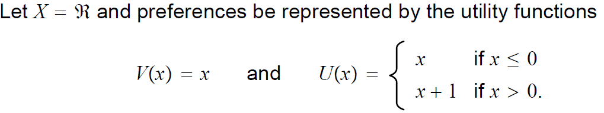
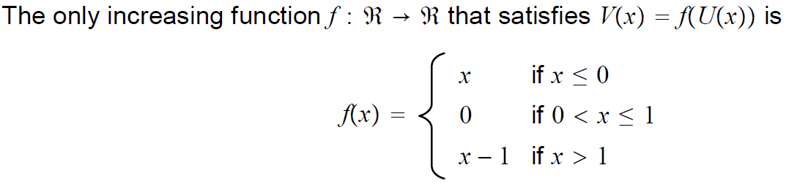
Problem
a) Is the statement “if both U and V represent ≿, then there is a strictly monotonic function f : ℝ → ℝ such that V(x) = f(U(x))” correct?
FALSE

Slide 64
Problem
b) Can a continuous preference relation be represented by a discontinuous utility function?
True: The preferences (x ≿ y if x ≥ y) is represented by U in (a) are continuous, though U is discontinuous

Slide 65
Problem
c) Show that in the case of X = ℝ , the preference relation that is represented by the discontinuous utility function u(x) = floor(x) is not a continuous relation
floor(x): the largest integer n such that x ≥ n

